Slide 1
Applied Regression
Dr. Frank Wood
TexPoint fonts used in EMF.
Read the TexPoint manual before you delete this box.: AA

Slide 2
Extra Sums of Squares
A topic unique to multiple regression
An “extra sum of squares” measures the marginal decrease in the error sum of squares when one or several predictor variables are added to the regression model, given that other variables are already in the model
Equivalently – one can view an extra sum of squares as measuring the marginal increase in the regression sum of squares.

Slide 3
Example
Multiple regression
  Output : Body fat percentage
  Input :
    triceps skin fold thickness (X₁)
    thigh circumference (X₂)
    midarm circumference (X₃)
Aim
  Replace cumbersome immersion procedure with model.
Goal
  Determine which predictor variable(s) provide a good model

Slide 4
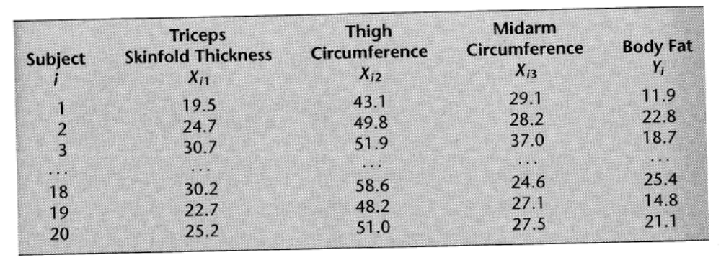
The Data

Slide 5
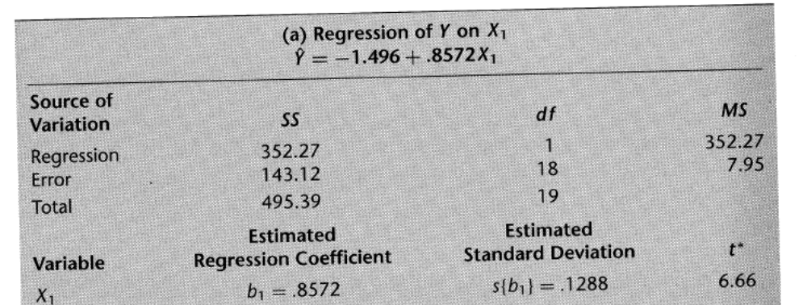
Regression of Y on X₁

Slide 6
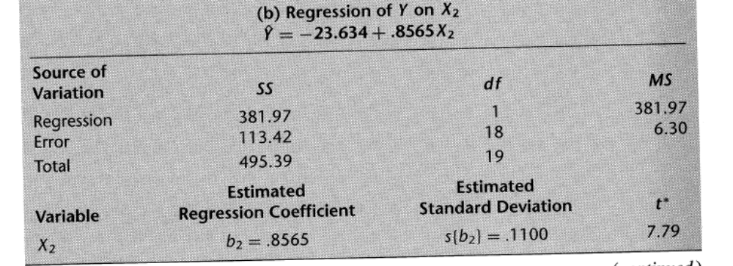
Regression of Y on X₂

Slide 7
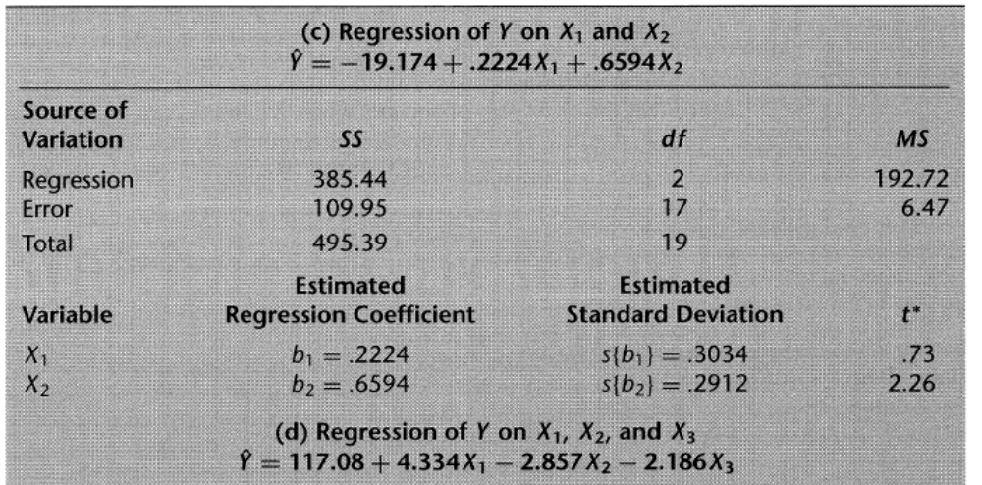
Regression of Y on X₁ and X₂

Slide 8
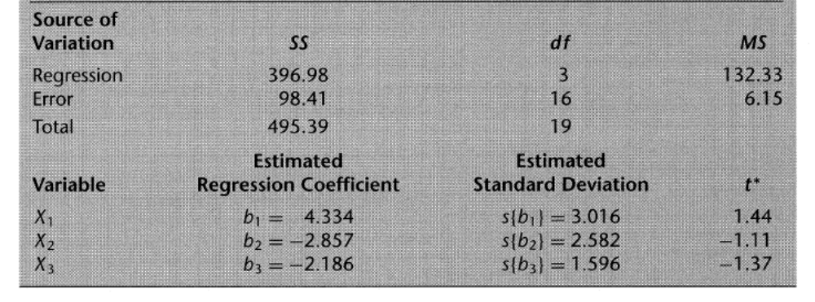
Regression of Y on X₁ and X₂ cont.

Slide 9
Notation
SSR X₁ only denoted by
  SSR(X₁) = 352.27
SSE X₁ only denoted by
  SSE(X₁) = 143.12
Accordingly
  SSR(X₁, X₂) = 385.44
  SSE(X₁, X₂) = 109.95

Slide 10
More Powerful Model, Smaller SSE
When X₁ and X₂ are in the model, SSE(X₁,X₂) = 109.95 is smaller than when the model contains only X₁
  SSE(X₁) = 143.12
The difference is called an extra sum of squares and will be denoted by
  SSR(X₂|X₁) = SSE(X₁) – SSE(X₁, X₂) = 33.17
The extra sum of squares SSR(X₂|X₁) measures the marginal effect of adding X₂ to the regression model when X₁ is already in the model.

Slide 11
SSR increase <-> SSE decrease
The extra sum of squares SSR(X₁|X₁) can equivalently be viewed as the marginal increase in the regression sum of squares
  SSR(X₂|X₁) = SSR(X₁,X₂) – SSR(X₁)
  = 385.44 – 352.27 = 33.17

Slide 12

Why does this relationship exist?
Remember
SSTO measures only the variability of the Y’s and does not depend on the regression model fitted
Any increase in SSR must be accompanied by a corresponding decrease in the SSE.

Slide 13
Example relations
SSR(X₃ | X₁, X₂) = SSE(X₁, X₂) – SSE(X₁,X₂,X₃)
  = 109.95 – 98.41 = 11.54
or SSR(X₃ | X₁, X₂) = SSR(X₁,X₂,X₃)-SSR(X₁, X₂)
  = 396.98-385.44 = 11.54
or with multiple variables included at a time
  SSR(X₂,X₃ | X₁) = SSE(X₁) – SSE(X₁,X₂,X₃)
    = 143.12 – 98.41 = 44.71
  or SSR(X₂,X₃ | X₁) = SSR(X₁,X₂,X₃)-SSR(X₁)
    = 396.98 – 352.27 = 44.71

Slide 14
Extra sums of squares
An extra sum of squares always involves the difference between the error sum of squares for the regression model containing the X variable(s) in the model already and the error sum of squares for the regression model containing both the original X variable(s) and the new X variable(s).

Slide 15
Definition(s)
Definition
  SSR(X₁ | X₂) = SSE(X₂) – SSE(X₁,X₂)
Equivalently
  SSR(X₁ | X₂) = SSR(X₁,X₂) - SSR(X₂)
We can switch the order of X₁ and X₂ in these expressions
We can easily generalize these definitions for more than two variable
  SSR(X₃ | X₁, X₂) = SSE(X₁,X₂) – SSE(X₁,X₂,X₃)
  SSR(X₃ | X₁, X₂) = SSR(X₁,X₂,X₃) - SSR(X₁,X₂)

Slide 16
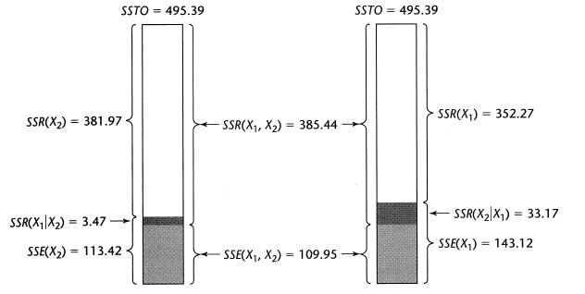
N! Different Partitions

Slide 17
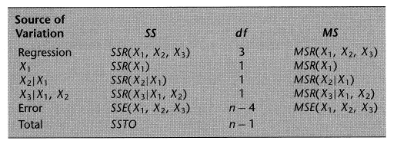
ANOVA Table
Various software packages can provide extra sums of squares for regression analysis
These are usually provided in the order in which the input variables are provided to the system, for instance

Slide 18
Why? Who cares?
Extra sums of squares are of interest because they occur in a variety of tests about regression coefficients where the question of concern is whether certain X variables can be dropped from the regression model.

Slide 19
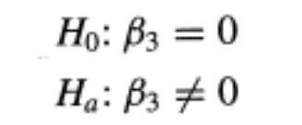
Test whether a single ¯_{k} = 0
Does X_{k} provide statistically significant improvement to the regression model fit?
We can use the general linear test approach
Example
  First order model with three predictor variables
  We want to answer the following hypothesis test

Slide 20
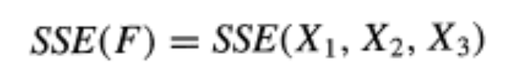

Test for single ¯_{k} = 0
For the full model we have
The reduced model (¯₃ = 0) is
And for this model we have
Where there are df_{r} = n-3 degrees of freedom associated with the reduced model

Slide 21


Test for single ¯_{k} = 0
The general linear test statistic is
which becomes
but

Slide 22
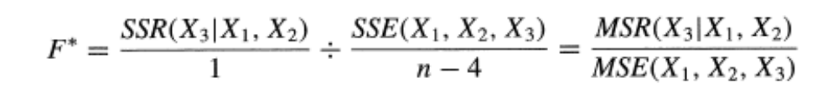
Test for single ¯_{k} = 0
The general linear test statistic is
Extra sum of squares has one associated degree of freedom

Slide 23
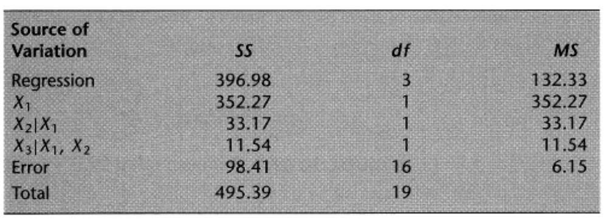
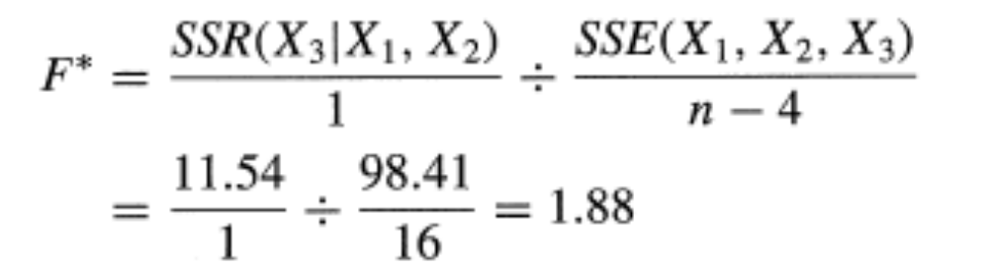
Example
Body fat : Can X₃ (midarm circumference) be dropped from the model?

Slide 24
Example Cont.
For ® = .01 we require F(.99; 1, 16) = 8.53
We observe F* = 1.88
We conclude H₀, ¯₃ = 0

Slide 25
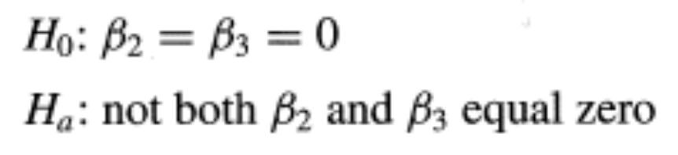
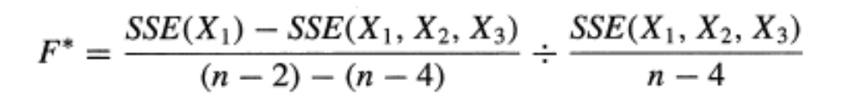
Test whether several ¯_{k} = 0
Another example
The general linear test can be used again
But
so the expression can be simplified

Slide 26
Tests concerning regression coefficients
Summary
  General linear test can be used to determine whether or not a predictor variable (or sets of predictor variables) should be included in the model
  The ANOVA SSE’s can be used to compute F* test statistics
  Some more general tests require fitting the model more than once unlike the examples given.

Slide 27
Standardized Multiple Regression
Numerical precision errors can occur when
  (X’X)^{-1} is poorly conditioned (near singular)
    colinearity
  And when the predictor variables have substantially different magnitudes
Solution
  Regularization
  Standardized multiple regression
First, transformed variables

Slide 28

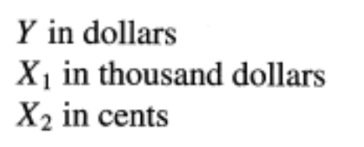
Correlation Transformation
Makes all entries in the X’X matrix for the transformed variables fall between -1 and 1 inclusive.
Another motivation
  Lack of comparability of regression coefficients
  Which is most important predictor?

Slide 29
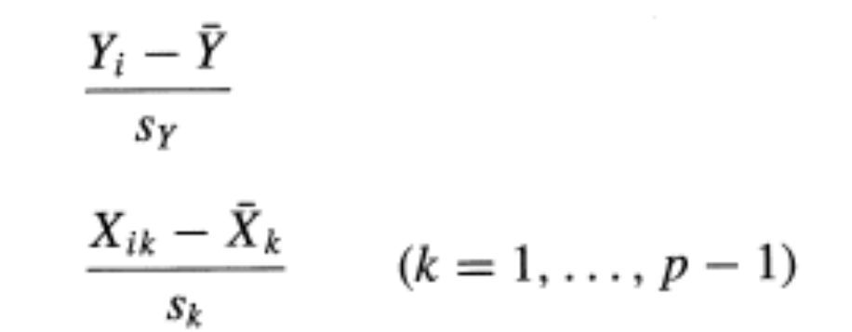
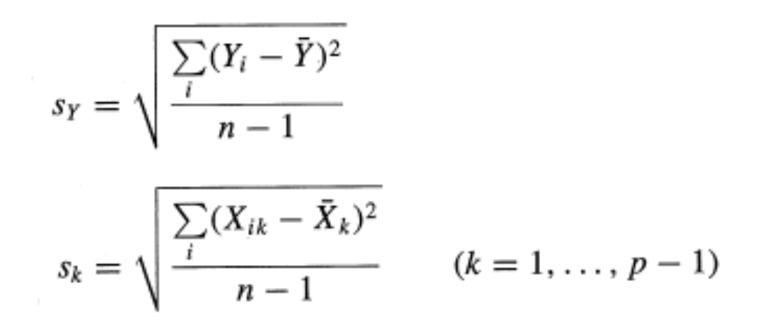
Correlation Transformation
Centering
Scaling

Slide 30
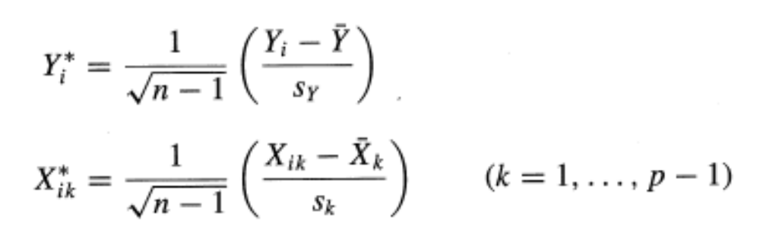
Correlation Transformation
Transformed variables

Slide 31
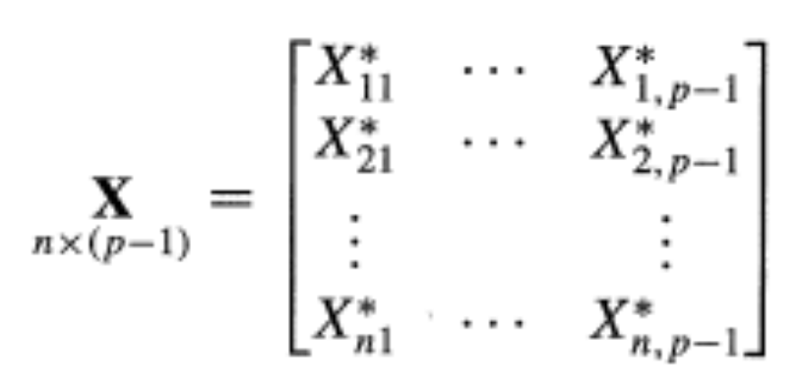
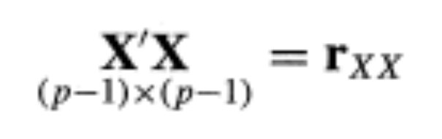
Standardized Regression Model
Define the matrix consisting of the transformed X variables
And define

Slide 32
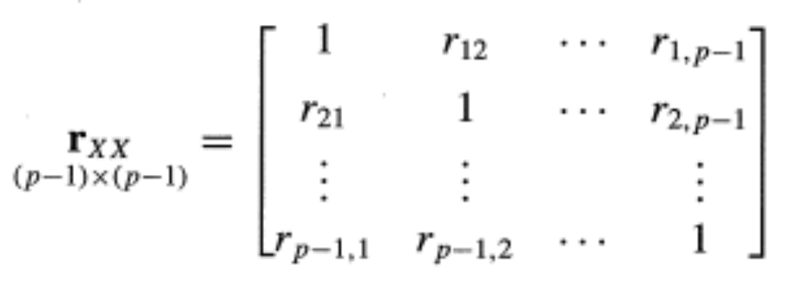
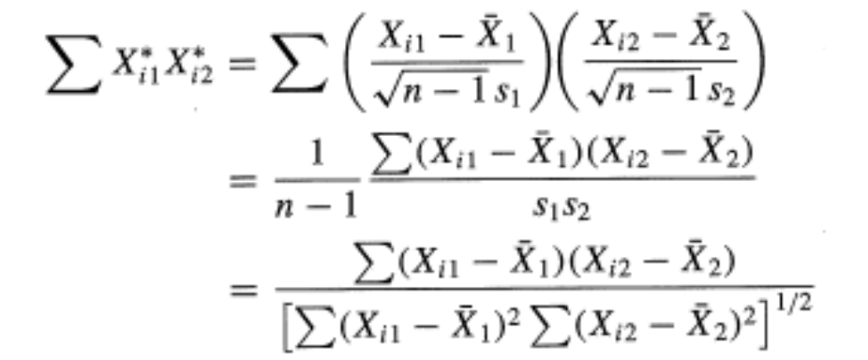
Correlation matrix of the X variables
Can show that
where each entry is just the coefficient of correlation between X_{i} and X_{j}

Slide 33
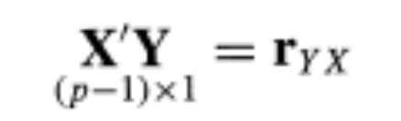
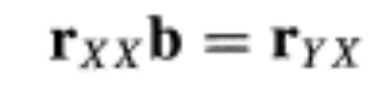
Standardized Regression Model
If we define in a similar way
where r_{Yj} is the coefficient of simple correlations between the response variable Y and X_{j}
Then we can set up a standard linear regression problem

Slide 34
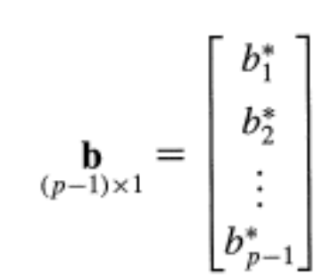
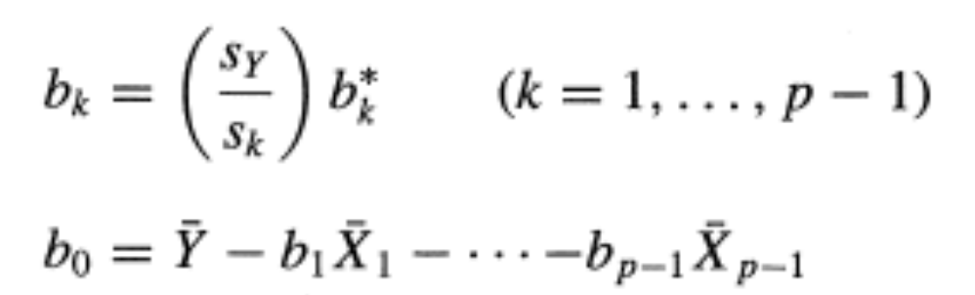
Standardized Regression Model
The solution
can be related to the solution to the untransformed regression problem through the relationship

Slide 35
Multi-colinearity
Brief comments
(X’X)^{-1} must be full rank to compute regression solution
  rank(AB) <= min(rank(A), rank(B))
Multi-colinearity means that rows of X are linearly dependent
Regression solution is degenerate
High degrees of colinearity produce numerical instability
Very important to consider in real world applications

